Slide 1
Text Mining and Wordcloud
Using R

Slide 2
Before we start
https://bit.ly/2S6Ttqt to see this presentation
https://bit.ly/2FQXyZU to download all datasets

Slide 3
Who I Am
Raden Muhammad Hadi
Mathematical Modeler - Software Engineer @ Quantus Telematika Indonesia
Mathematics Graduate, specializing in Algebra (read: Abstract Nonsense)
R user for 6 years
Also speak Java, Javascript, and Python

Slide 4
Outline:
Introduction to Text Mining
Text Mining Workflow
Basic R
Let’s Mining!
Preprocessing!
Visualize!

Slide 5
Text Mining
Text mining is the process of analyzing collections of textual materials in order to capture key concepts and themes and uncover hidden relationships and trends without requiring that you know the precise words or terms that authors have used to express those concepts.
Source: https://www.ibm.com/

Slide 6
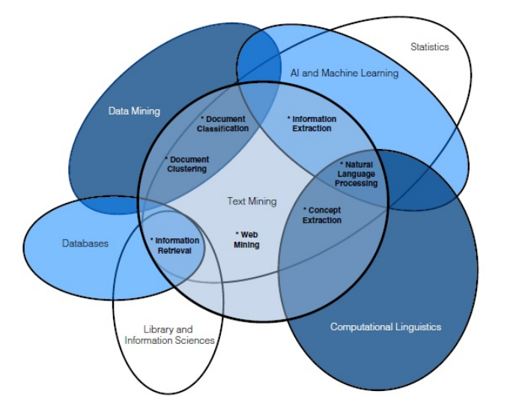
Text Mining
Venn Diagram

Slide 7
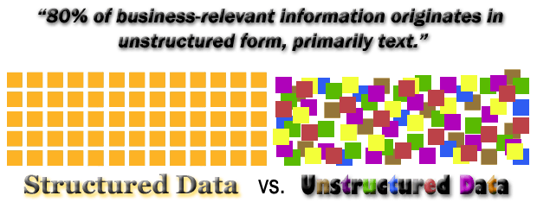

Slide 8
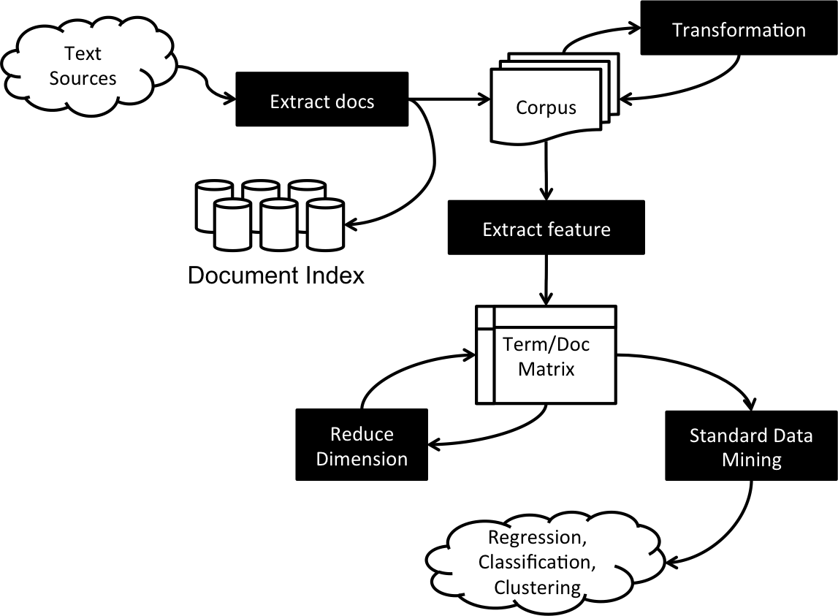
Typical Text Mining Workflow

Slide 9
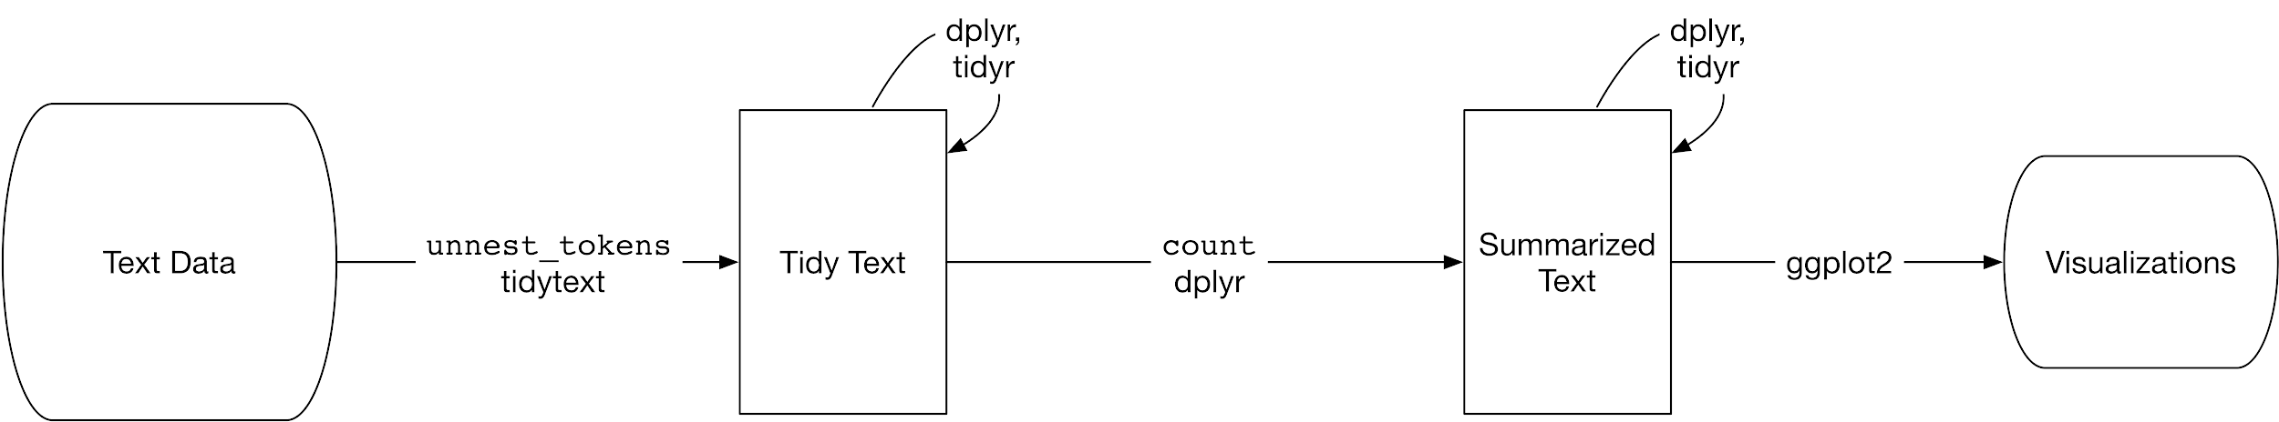
Source: https://www.tidytextmining.com/images/tidyflow-ch-1.png
Our Simple Workflow

Slide 10
Why R?

Slide 11
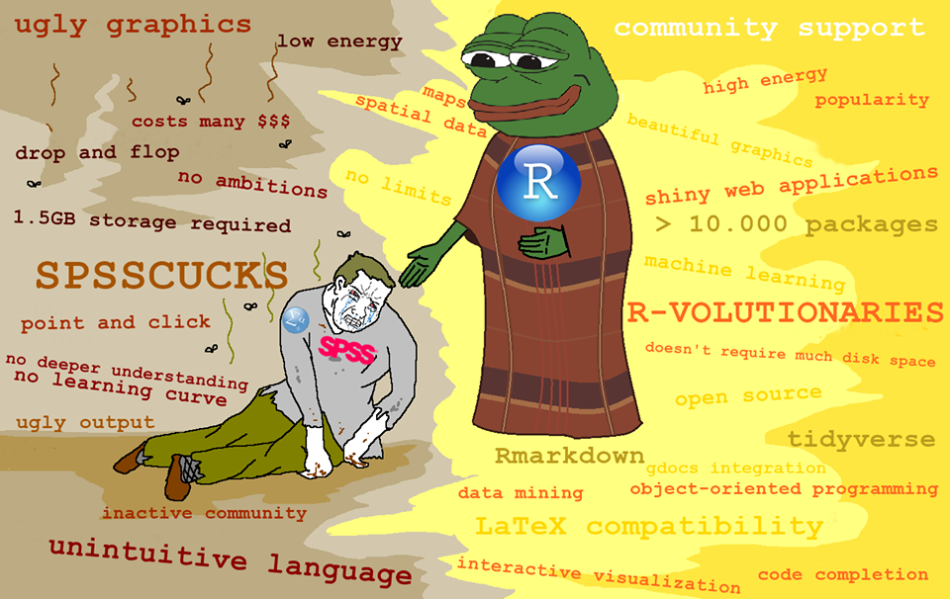

Slide 12
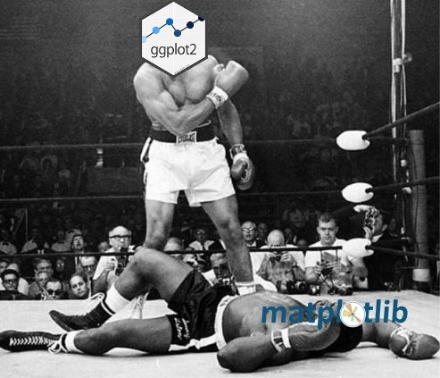

Slide 13
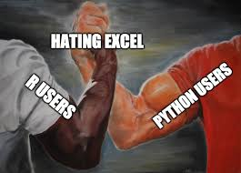

Slide 14
Basic R

Slide 15
Let’s Mining!
R package you need
rvest for web-scraping
textreadr for document scraping
dplyr for simplifying our workflow

Slide 16
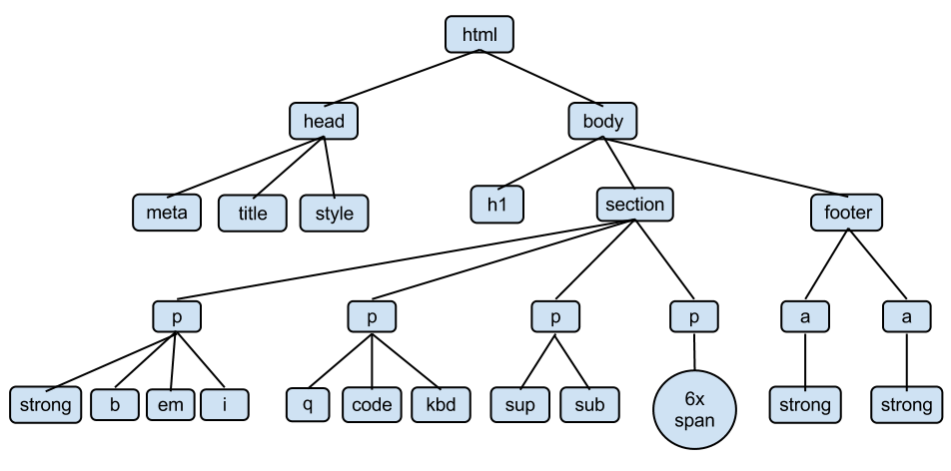
Source: http://www.openbookproject.net/tutorials/getdown/css/images/lesson4/HTMLDOMTree.png
Structure of Web Page

Slide 17
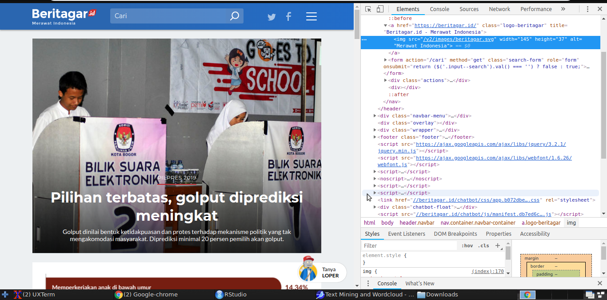

Slide 18
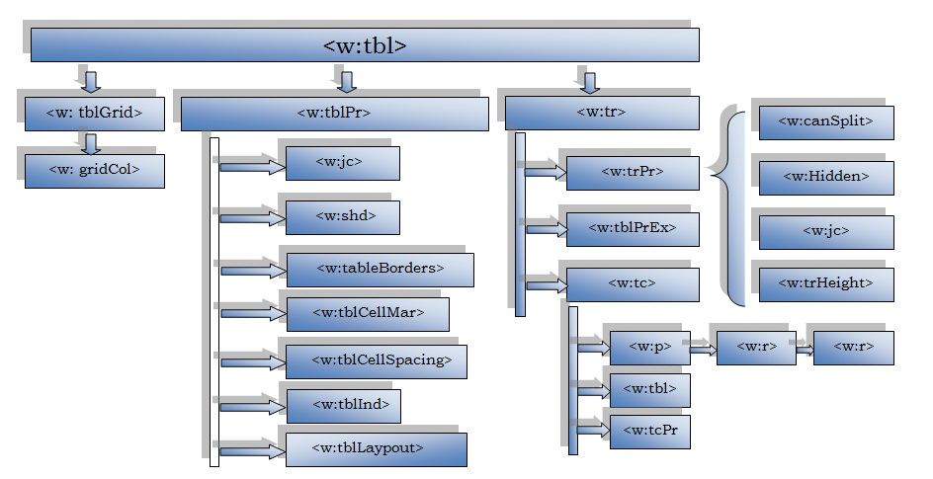
Source: https://www.codeproject.com/KB/cs/1043875/openstablestructure.jpg
Structure of Document File (OpenXML)

Slide 19

rvest helps you scrape information from web pages. It is designed to work with magrittr to make it easy to express common web scraping tasks

Slide 20

textreadr is a small collection of convenience tools for reading text documents into R.

Slide 21

The magrittr (to be pronounced with a sophisticated french accent) is a package with two aims: to decrease development time and to improve readability and maintainability of code. Or even shortr: to make your code smokin' (puff puff)!

Slide 22
CSS Selector
Selector | Example | Example Description
.class | .title | Pilih semua elemen dengan class = ”title”
#id | #artikel | Pilih semua elemen dengan id = “artikel”
* | * | Pilih semua elemen
element | p | Pilih semua elemen <p>
element, element | p, div | Pilih semua elemen p dan div
[attribute] | [href=”https”] | Pilih semua elemen dengan attribute href=”https”
More about CSS Selector: https://www.w3schools.com/cssref/css_selectors.asp

Slide 23
XPATH
Expression | Example | Description
nodename | h1 | Pilih semua node dengan nama h1
/ | /h1 | Pilih root element dari h1
// | //artikel | Pilih semua elemen dari artikel tanpa melihat root element
@ | //@href | PIlih semua atribut dengan nama href
More about XPATH: https://www.w3schools.com/xml/xpath_syntax.asp

Slide 24
Preprocessing!
R package you need
tidytext for tokenizing, easy preprocessing task
dplyr for easy wrangling

Slide 25
Preprocessing Task
All we need to do:
Tokenizing
Lowercasing every characters
Eliminating punctuations
Eliminating stopwords

Slide 26
Visualize!
R package you need
wordcloud or wordcloud2 to make your text ‘cloudy’ (pardon my English)

Slide 27
Be Resourceful!
Some links you need to know:
Text Mining for Social Scientist and Digital Humanist: https://tm4ss.github.io/
Text Mining Using R: https://www.tidytextmining.com/
Handling and Processing Strings in R: https://www.gastonsanchez.com/Handling_and_Processing_Strings_in_R.pdf
rvest Documentation: https://github.com/hadley/rvest

Slide 28
Thanks!
Meet me at:
Instagram: @math_adventurer
Linkedin: bit.ly/radenmhadi
Github: hadimaster65555
Personal Web: hadimaster65555.github.io

Slide 29

Join Indonesia useR! Community
Link:
https://t.me/GNURIndonesia

